Slide 1


TEAM
THE FUHRERS
Exploring Benford's and Zipf's Laws in Real-World Datasets
Vidhan Pandey
SOURYA
TANUSH KUMAR

Slide 2

ABOUT US
We are a team focused on exploring Benford's Law and Zipf's Law to analyze real-world datasets. Our project investigates the frequency distributions of digits and words, offering valuable insights into hidden patterns and anomalies in data.

Slide 3

THE Fuheres
KEY FINDINGS
Benford’s Law:
Digit distributions followed Benford’s Law in most datasets, with a higher frequency of lower digits.
Anomalies in some datasets showed possible data irregularities or manipulation.
Zipf’s Law:
Word frequencies followed Zipf's Law, where a few words appeared very frequently, while many words occurred rarely.
The law was evident in text-heavy datasets like news articles and books.
Real-World Relevance:
These laws are useful for detecting fraud (Benford’s Law) and analyzing language structure (Zipf’s Law).

Slide 4
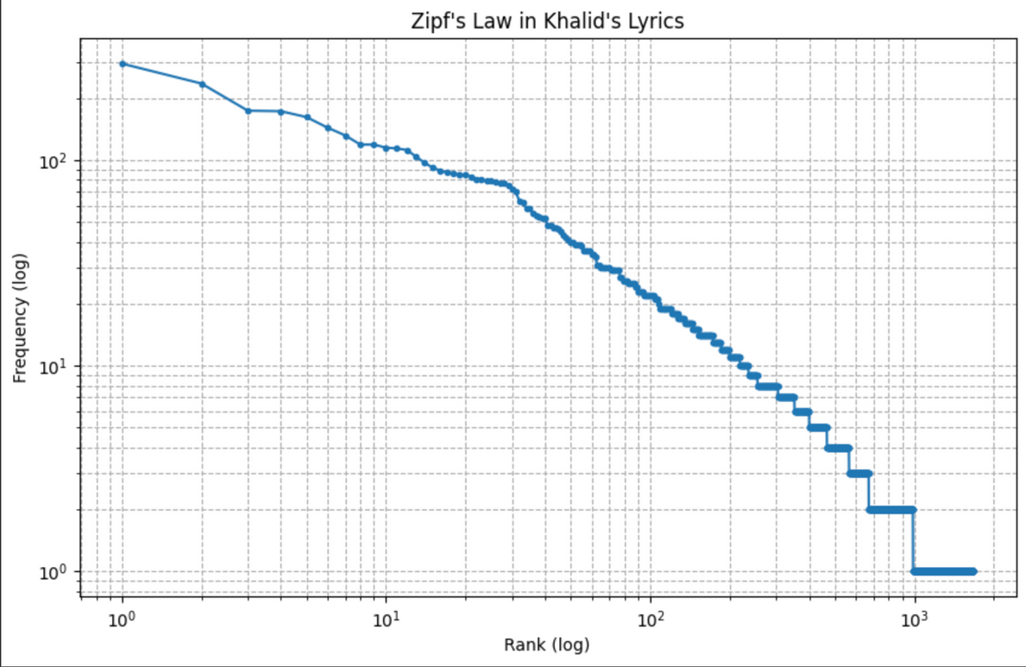
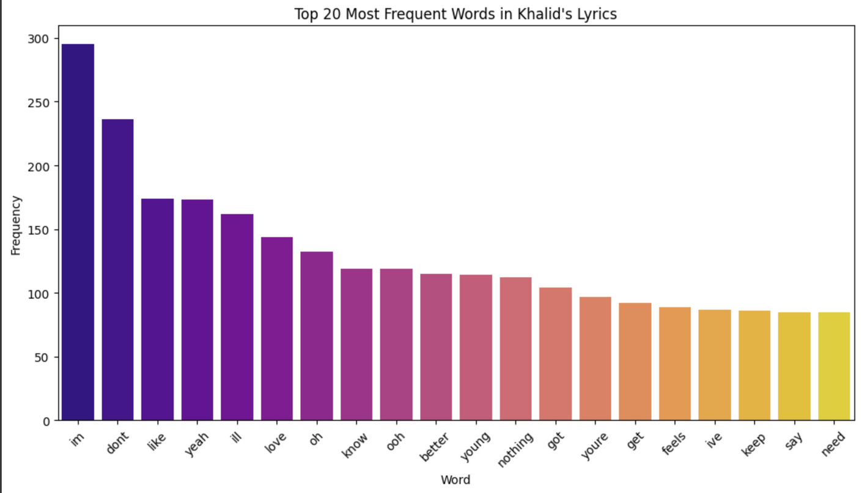
VISUALIZATIONS & GRAPHS
The Fuheres

Slide 5
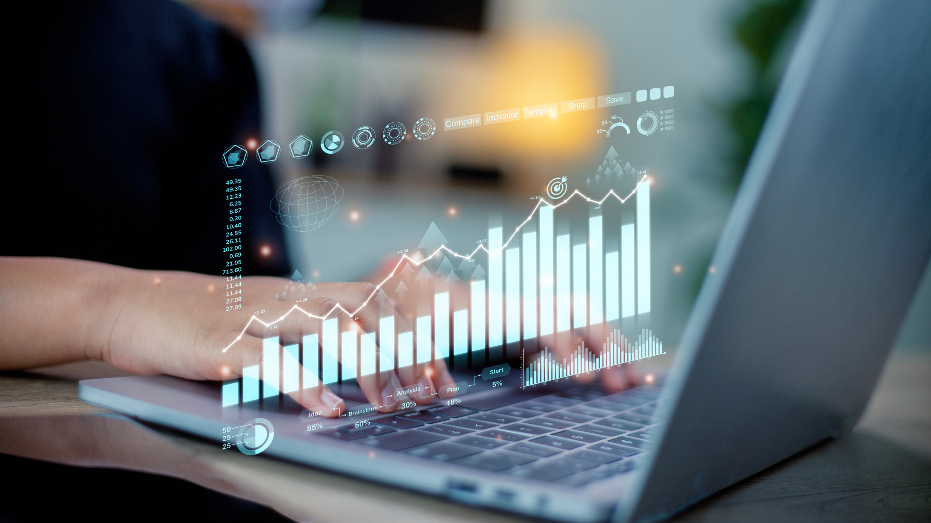
The Fuhrers
CONCLUSION
Summary of Findings:
Zipf’s Law: The dataset's word frequency distribution largely conformed to Zipf’s Law, where a few words were used frequently, while the majority were used sparingly.
Benford’s Law: Some datasets followed Benford’s Law, but anomalies were noted in others. This could suggest areas for deeper analysis or concerns about the integrity of the data.
Applications:
Understanding natural language distribution through Zipf’s Law.
Using Benford’s Law for fraud detection, especially in financial datasets.
Limitations:
The presence of outliers and deviations in both laws highlights the need for careful data validation before concluding any analysis.

Slide 6
The Fuhrers
FUTURE GOAL’S
Deeper Analysis:
We plan to explore datasets that don't follow Benford's Law to better understand why certain datasets show deviations, particularly in fields like finance, where such anomalies could indicate potential fraud or errors.
We want to investigate Zipf's Law in different contexts, like social media posts or website traffic, to see how it applies across various data types.
Improvement:
We'll analyze larger datasets to further validate the patterns we’ve observed with Benford's and Zipf's Laws.
We plan to implement more advanced statistical techniques to refine our analysis and reduce inaccuracies, especially for non-natural datasets.
Collaboration:
We’re looking to work with data scientists or domain experts to apply these findings in real-world scenarios, especially in areas like fraud detection, to turn our theoretical insights into practical solutions.

Slide 7
The Fuheres
CONTRIBUTIONS
Vidhan Pandey
Collected and cleaned datasets
Performed detailed EDA and applied Benford’s and Zipf’s Law
Created graphs, interpreted results, and built the iPython Notebook
Drafted major sections of the presentation and compiled final outputs
Sourya
Assisted in structuring the presentation slides
Helped validate Zipf’s Law word frequency outputs
Gave inputs on visualization ideas
Tanush Kumar
Contributed to team discussions
Reviewed overall flow and helped finalize the presentation format

Slide 8
THANK YOU! 🙏
WE APPRECIATE YOUR TIME AND ATTENTION.
IT WAS A GREAT LEARNING EXPERIENCE WORKING ON THIS PROJECT!
— TEAM THE FÜHRERS

